Slide 1

Customer Experience across Industries
Marketing Content
May 10, 2024

Slide 2
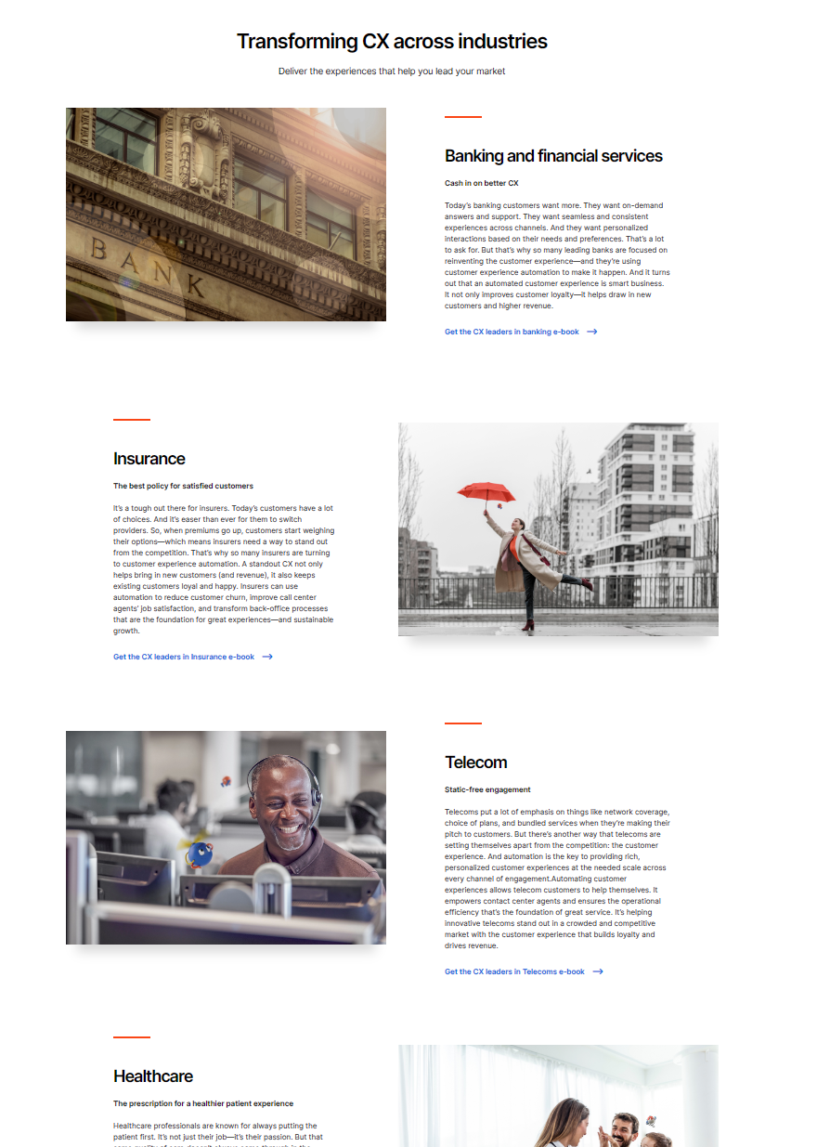
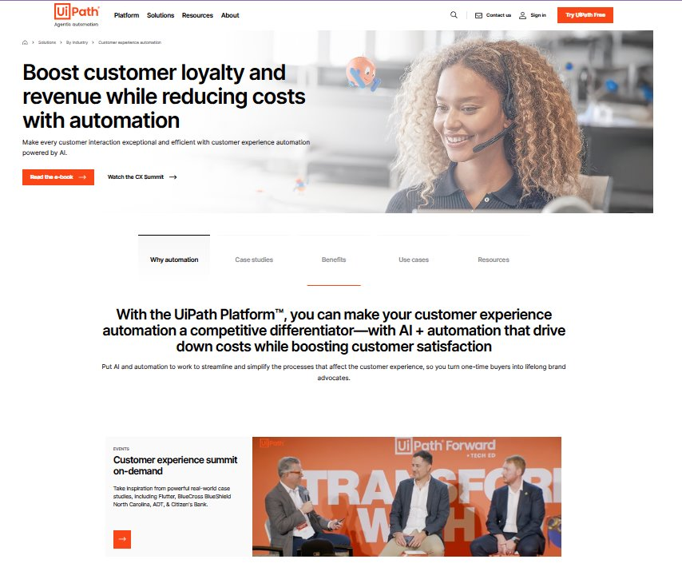
NEW Customer Experience webpage
https://www.uipath.com/solutions/industry/customer-experience-automation

Slide 3
IDC Analyst paper
Marketing content pack
Providing ROI from Customer experiene

Slide 4
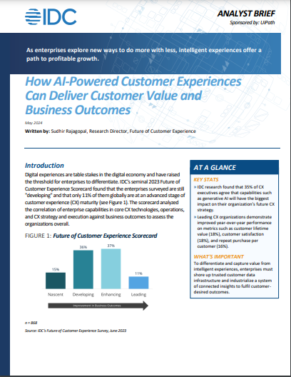
Customer Experience: IDC Analyst Brief How AI-powered automation can boost customer value
NEW IDC Analyst Brief on customer experience use cases (in English)
Audience: Top of funnel asset for customer experience leaders across all industries
Intro: Digital experiences are table stakes in the digital economy and have raised
the threshold for enterprises to differentiate. IDC's seminal 2023 Future of
Customer Experience Scorecard found that the enterprises surveyed are still
"developing" and that only 11% of them globally are at an advanced stage of
customer experience (CX) maturity.
This analyst brief emphasizes how AI-powered automation can boost customer value and it also includes four practices that enterprises must adopt to deliver experiences that truly make an impact.
Campaign pages
Registration Page
Direct link to PDF (for 1x1 distribution only)
HQ post
Internal resources
Campaign folder in SharePoint
Launch date: Q2 FY25
SFDC code: AR24IDCCX

Slide 5
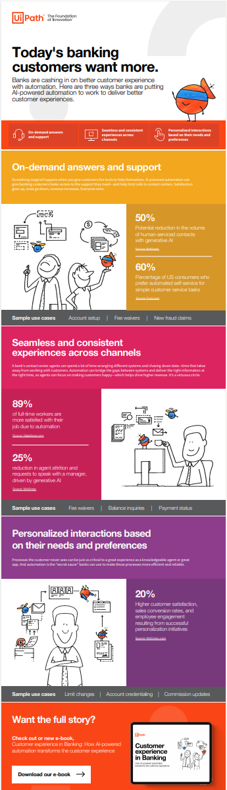
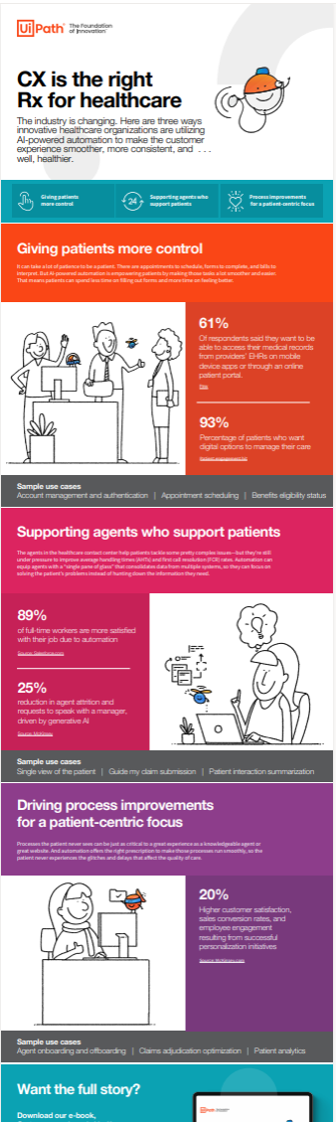
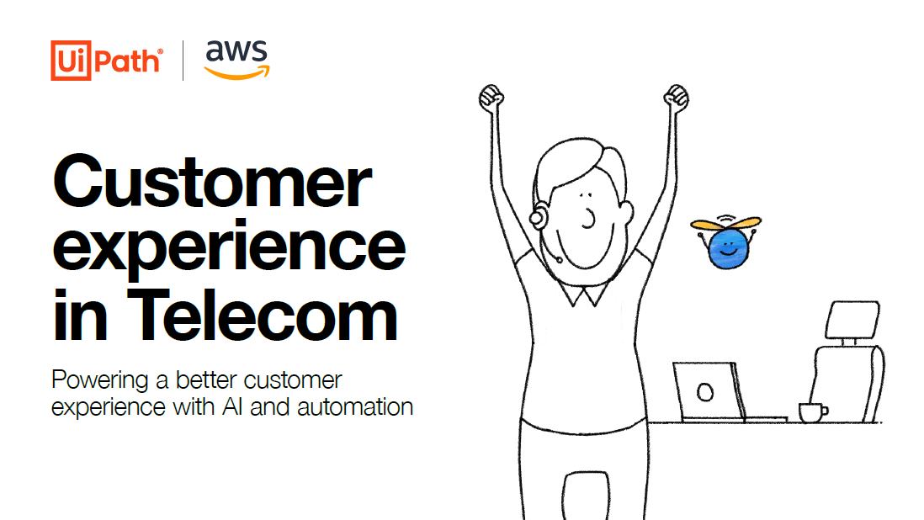

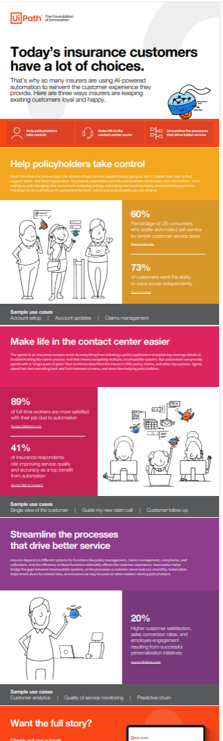
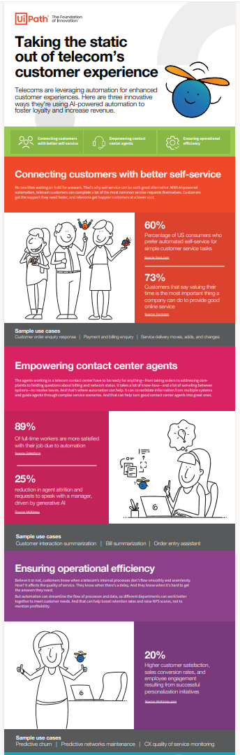
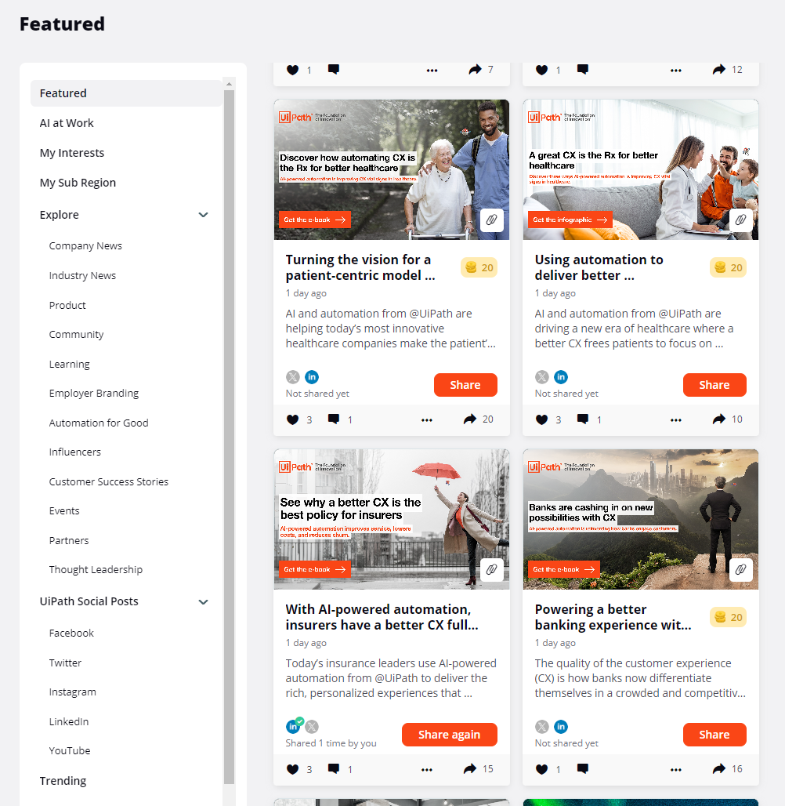
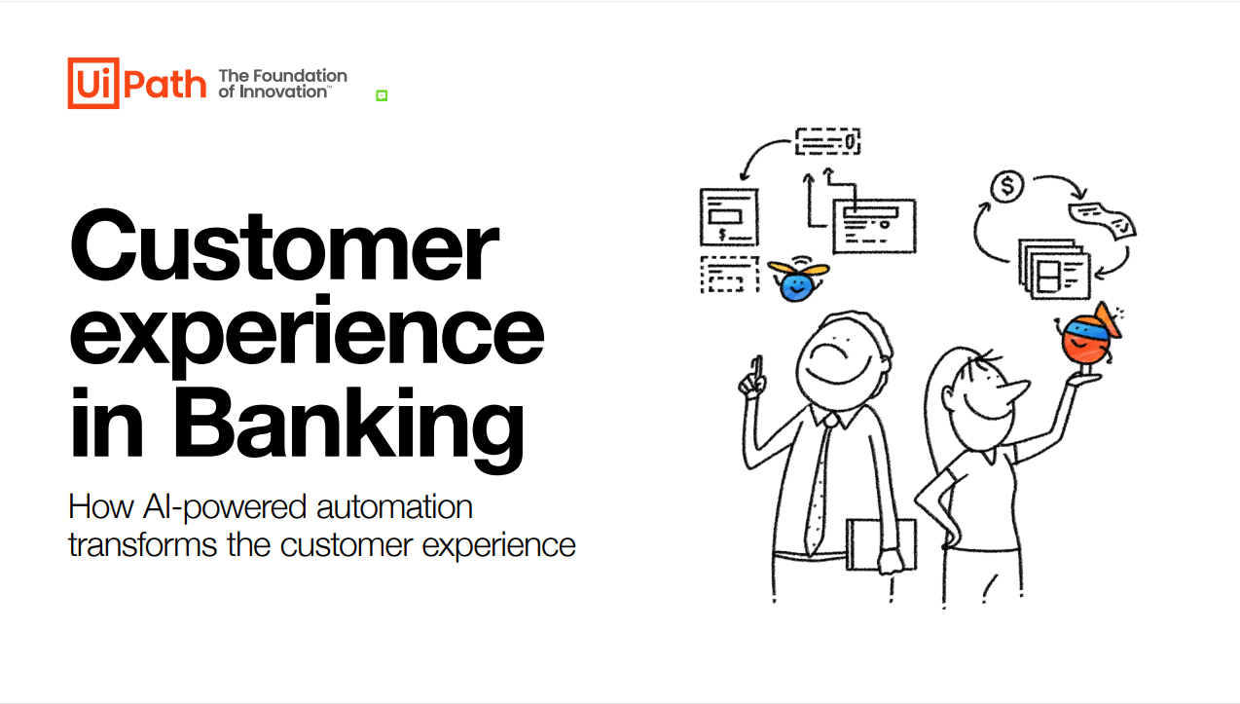
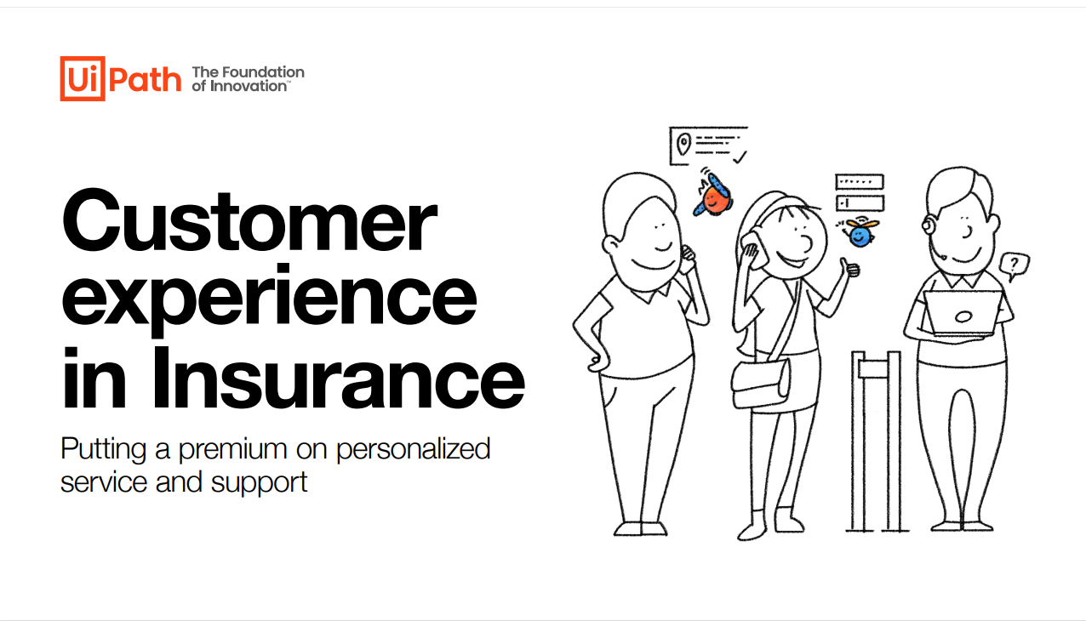
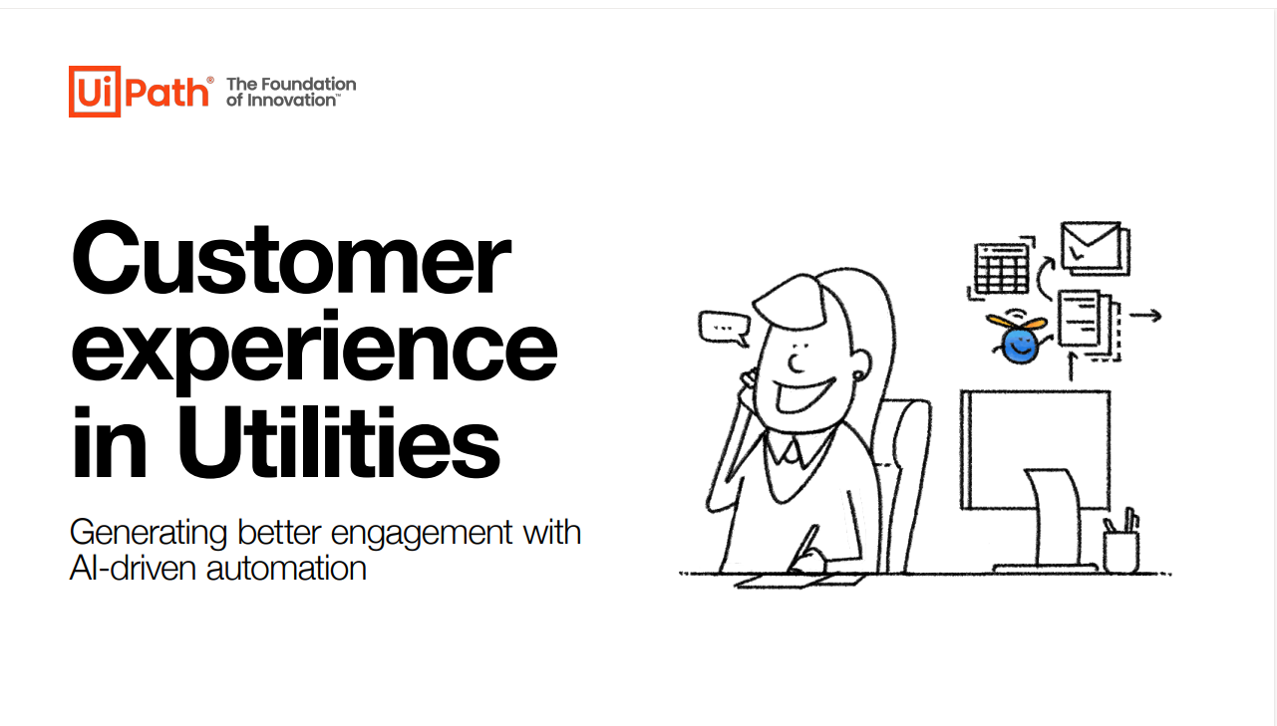
Customer Experience: e-books, infographics & social posts
Sets for each industry: Healthcare, Banking, Insurance and Telecommunications & Utilities
https://uipath.highspot.com/items/61fd4b551970f7eb701c3487

Slide 6
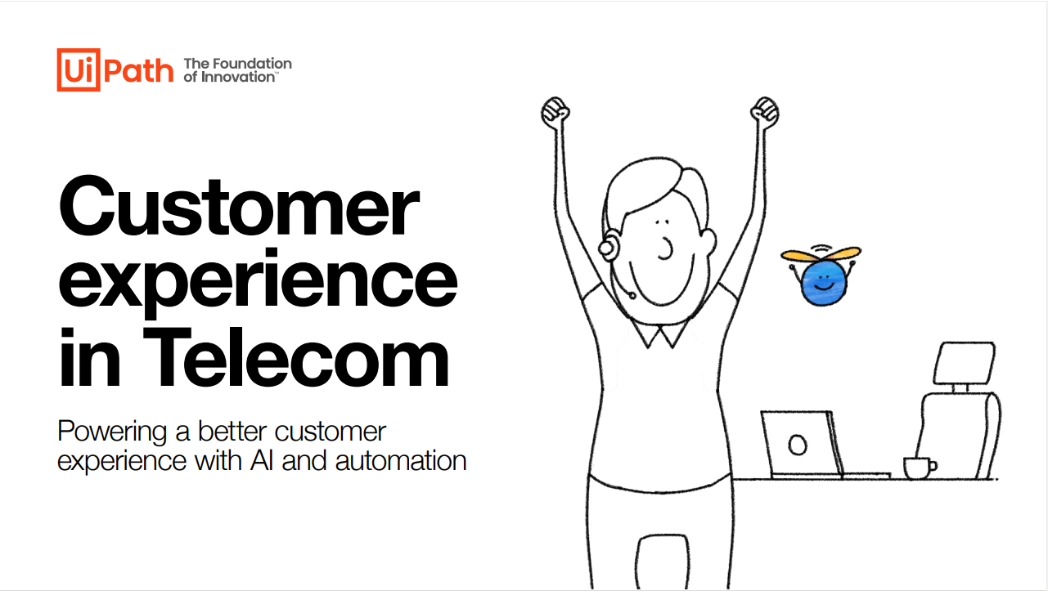
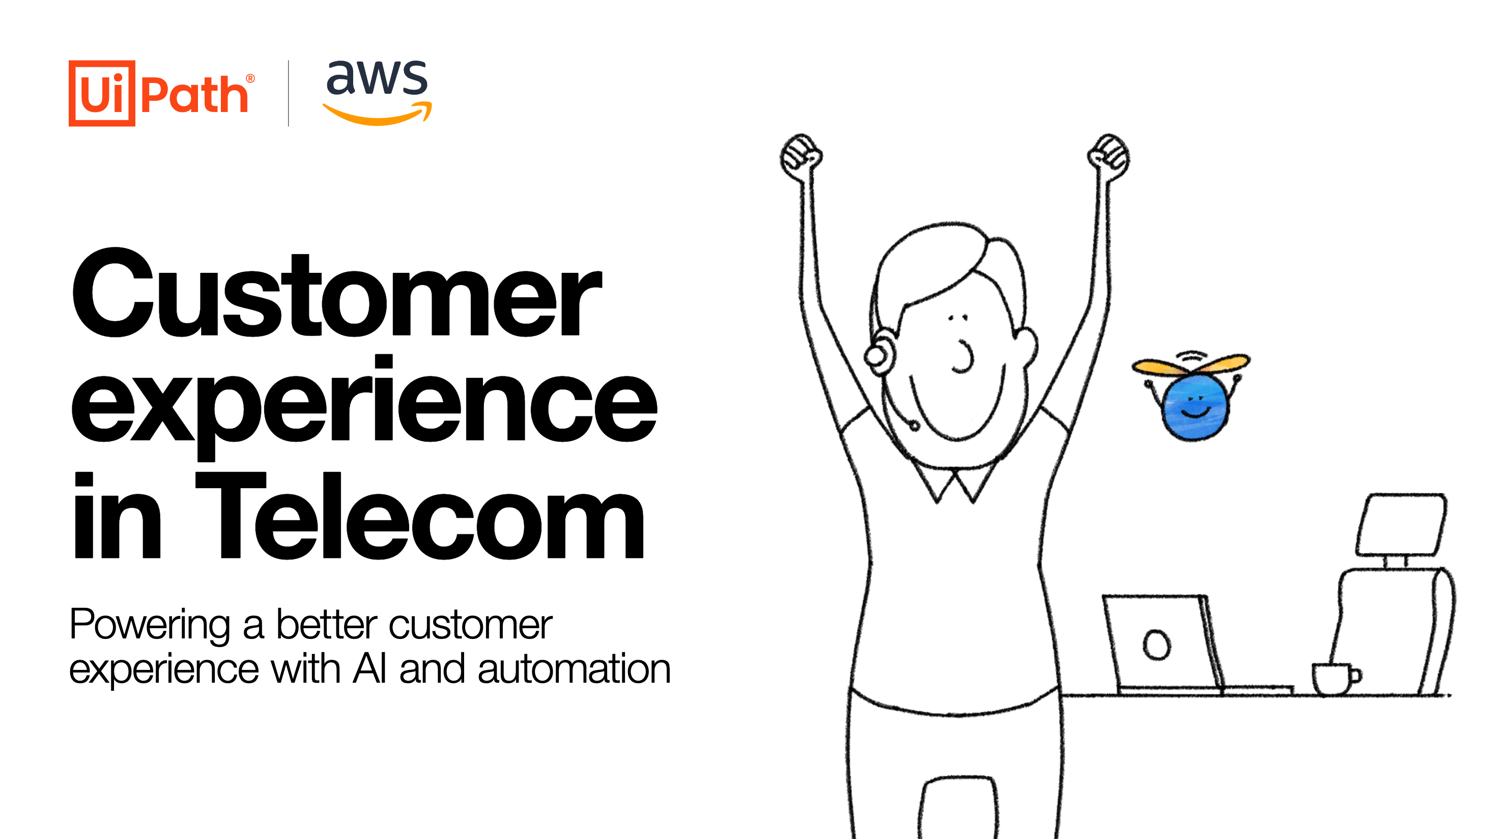

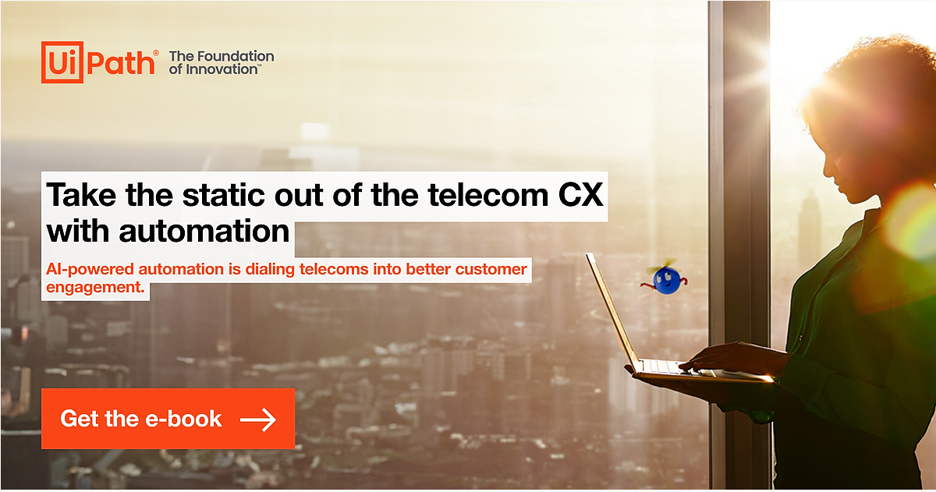
Customer Experience in Telecom
Marketing Content Pack (infographic, e-book, CFD, enablement and social posts)
NEW Telco e-book & infographic focused on customer experience
This free infographic and grated lead collecting e-book provides Telco customer use cases on their automation journey, from self-service to agent support and customer experience operations automation.
AI and automation work together to enable telecoms to predict customer sentiment, reduce churn rates, improve agents’ job satisfaction, and transform back-office processes, driving enhanced customer experiences. And our e-book showcases these transformative capabilities.
infographic HQ post
e-book HQ post
Campaign pages
E-book Registration Page
Customer content
Telco infographic
e-book HQ post
infographic HQ post
E-book Direct link to PDF
AWS e-book
Seller resources
Campaign folder in SharePoint
CFD & Enablement
Launch date: Q2 FY25
SFDC code: WP23CXTC

Slide 7
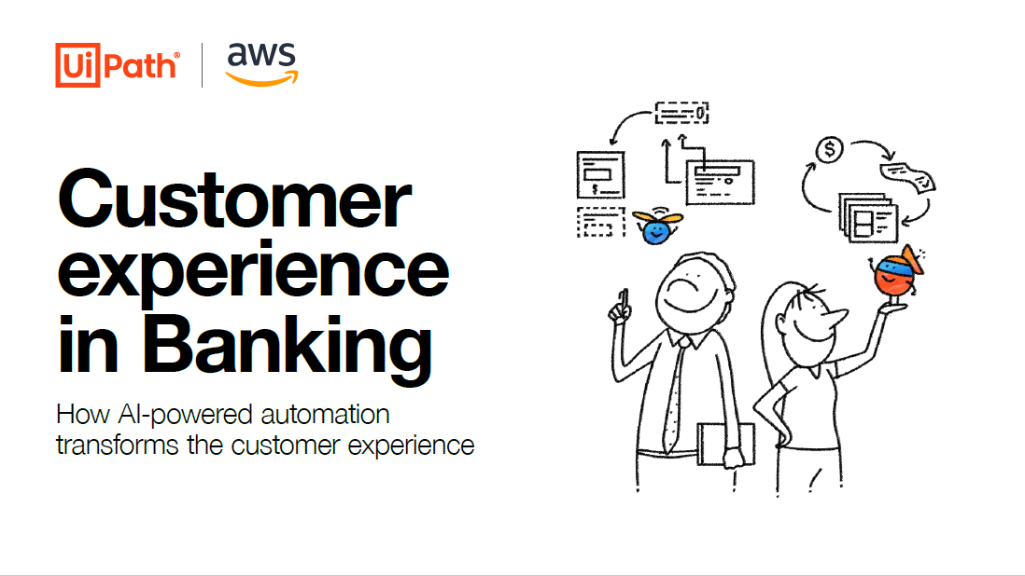
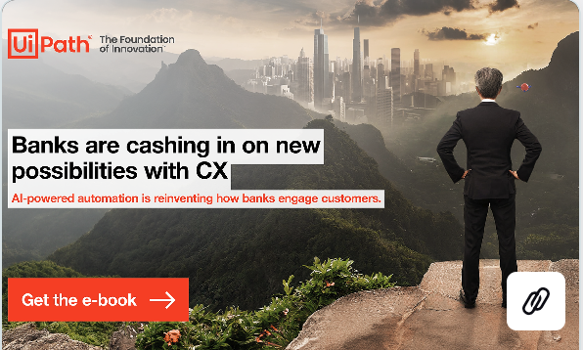
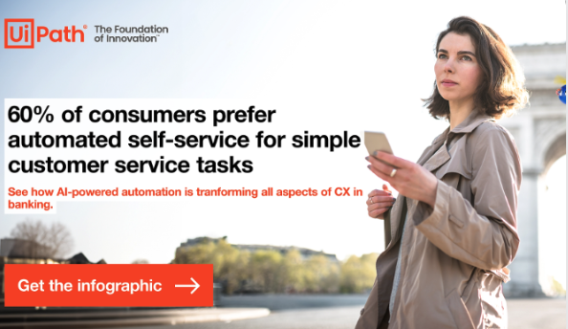
Customer experience in Banking
Marketing Content Pack (infographic, e-book, CFD, enablement and social posts)
NEW Banking e-book focused on customer experience –
The quality of customer experience is how many banks differentiate themselves in a crowded and competitive market. And for a growing number of banking industry leaders, automation is the driver of great customer experience.
This e-book provides Banking customer use cases on their automation journey, from self-service to agent support and customer experience operations automation.
e-book HQ post​
infographic HQ post​
Campaign pages
e-book registration Page
Customer content
Banking infographic
e-book HQ post
infographic HQ post
e-book direct link to PDF
AWS e-book
Seller resources
Campaign folder in SharePoint
CFD/enablement
Customer references
Launch date: Q4 FY24
SFDC code: WP23CXBFS

Slide 8
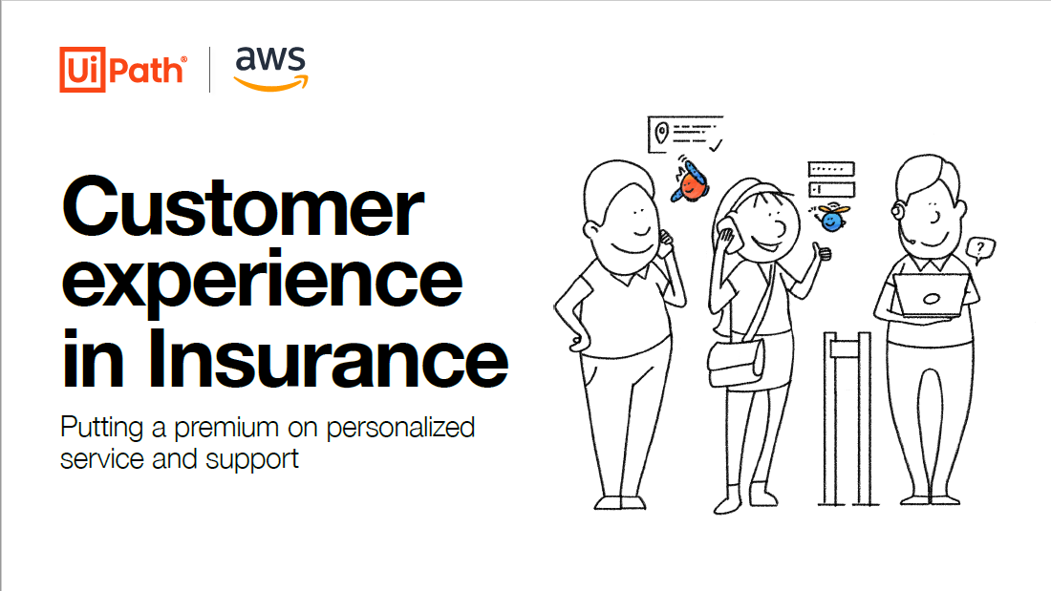
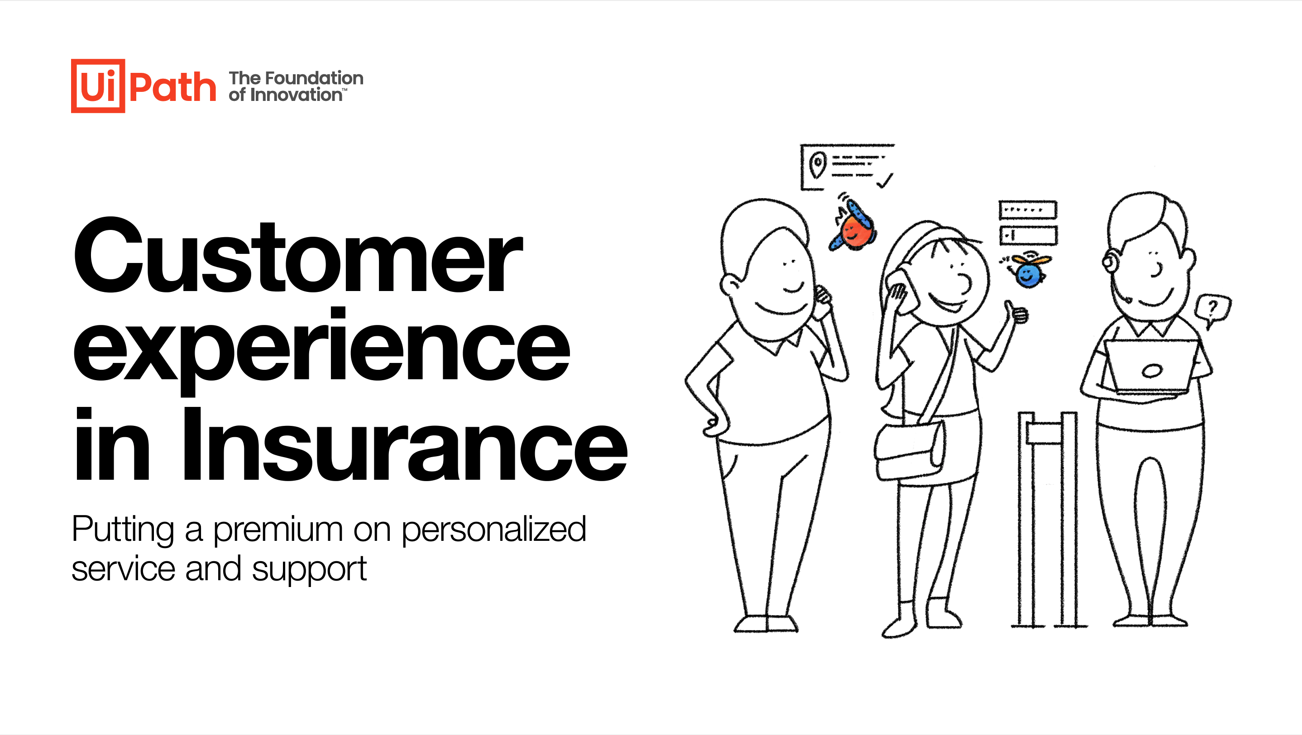
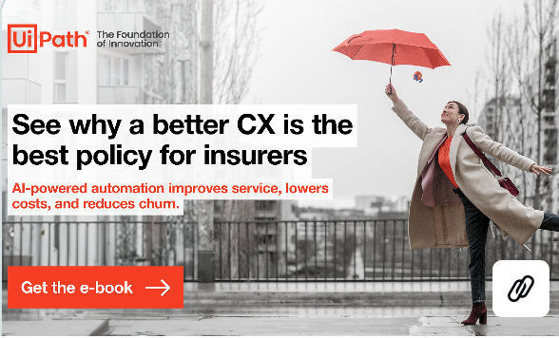
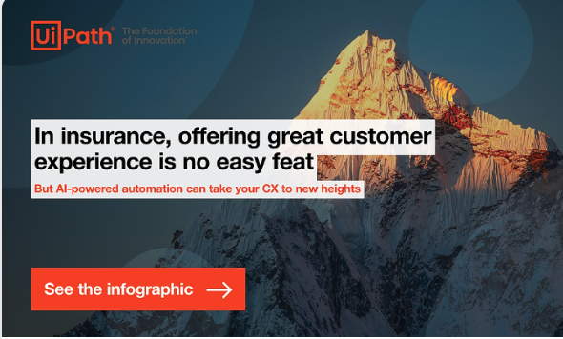
Customer experience in Insurance
Marketing Content Pack (infographic, e-book, CFD, enablement and social posts)
NEW Insurance e-book focused on customer experience – to be launched this week
In a competitive market where it’s simpler than ever to switch providers, insurance providers are looking for ways to stand out and attract new customers—while keeping the ones they already have happy.
This e-book provides Insurance customer use cases on their automation journey, from self-service to agent support and customer experience operations automation.
e-book HQ post
Infographic HQ post​
Campaign pages
e-book Registration Page
Customer Content
Insurance infographic
e-book HQ post
Infographic HQ post
e-book Direct link to PDF
AWS e-book
Seller resources
Campaign folder in SharePoint
CFD/enablement
Customer references
Launch date: Q4 FY24
SFDC code: WP23CXINS

Slide 9




Customer experience in Healthcare
Marketing Content Pack (infographic, e-book, CFD, enablement and social posts)
NEW Healthcare e-book focused on customer experience – to be launched this week
Scheduling appointments, completing paperwork, submitting claims, paying bills—they’re all part of the interaction with a healthcare organization. And when they don’t run smoothly, they can distract the patient and organization from focusing on what matters most: quality of care.
This e-book provides Healthcare customer use cases on their automation journey, from self-service to agent support and process improvements for a patient-centric focus.
e-book HQ post​
Infographic HQ post​
Campaign pages
e-book Registration Page
Customer Content
Healthcare infographic
e-book HQ post
Infographic HQ post
e-book Direct link to PDF
AWS e-book
Seller resources
Campaign folder in SharePoint
CFD/enablement
Customer references
Launch date: Q4 FY24
SFDC code: WP23CXHL

Slide 10
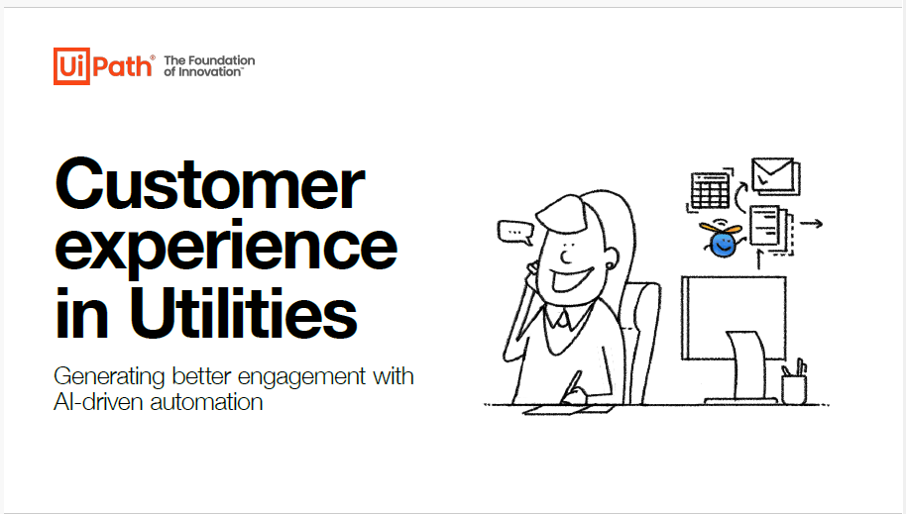
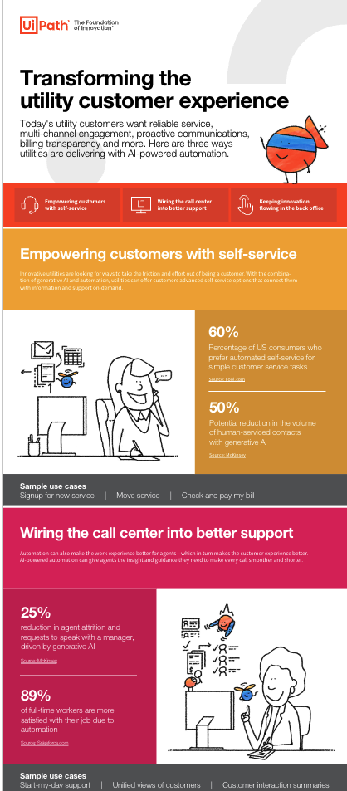

Customer experience in Utilities
Marketing Content Pack (infographic, e-book, CFD, enablement and social posts)
NEW Utilities e-book focused on customer experience (in English)
Audience: Top of funnel asset for Utilities leaders
Intro: When there’s a disruption in the service a utility provides, life stops. Customers expect power, gas, and water will flow when they need them. And it’s a big job to maintain the infrastructure and supply chains that keep things running. But utilities are finding that in addition to providing communities with essential services, they’re also in the business of managing customer relationships.
AI-powered automation enables utilities to make every customer interaction more personal, more efficient, and less expensive.
This e-book presents key areas that utilities leaders can automate to create innovative solutions and shape a brighter future for utility customer experience.
E-book HQ post​
Campaign pages
e-book Registration Page
Customer Content
Utilities Infographic
e-book HQ post
e-book Direct link to PDF
HQ post infographic (soon)
Seller resources
Campaign folder in SharePoint
Customer references
Launch date: Q2 FY25
SFDC code: EB24CXU

Slide 11
Custroemr Experience Summit
Marketing content pack
FORWARD 2024

Slide 12

Customer Experience Summit:
Revolutionizing Customer Interaction:
AI-Powered Automation Strategies for Enterprise Leaders
01
CX MythBusters
05
Demo: CX Companion
02
Customer spotlight: BlueCrossBlueShield NC
06
Customer spotlight: Citizen's Bank
03
07
Customer Spotlight: ADT & Ashling Partners
Customer spotlight: Flutter
04
Fireside chat with qBotica​

Slide 13
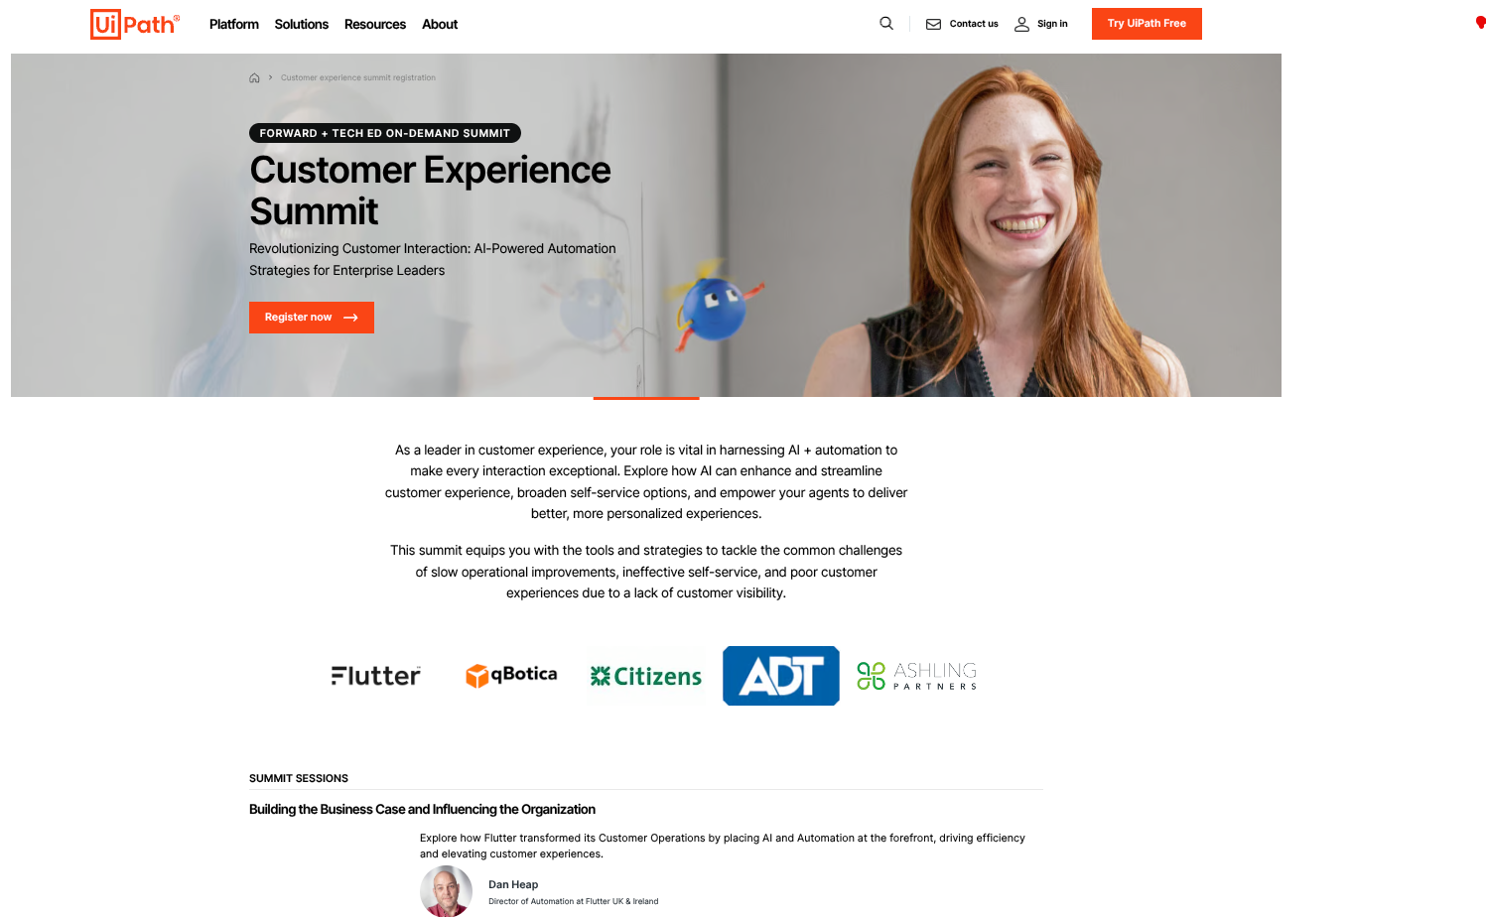

Customer Experience Summit
As a leader in customer experience, your role is vital in harnessing AI + automation to make every interaction exceptional. Explore how AI can enhance and streamline customer experience, broaden self-service options, and empower your agents to deliver better, more personalized experiences.
Campaign pages:
On-demand Summit registration page
Summit video sessions (internal only)
Email campaign:
Sales email (link to Sharepoint location)
Marketing collateral
HQ post
Social Copy
Promotion
CX solutions webpage
Contact Center webpage
Highspot
Launch date: Nov 15
Campaign code: VE24CEXS

Slide 14
CX Podcast
Marketing content pack
Demystifying the CX and Contact Center

Slide 15
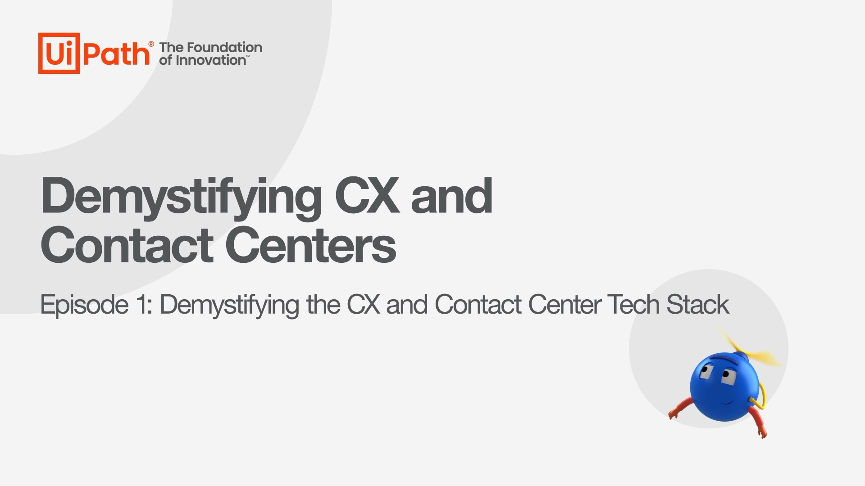
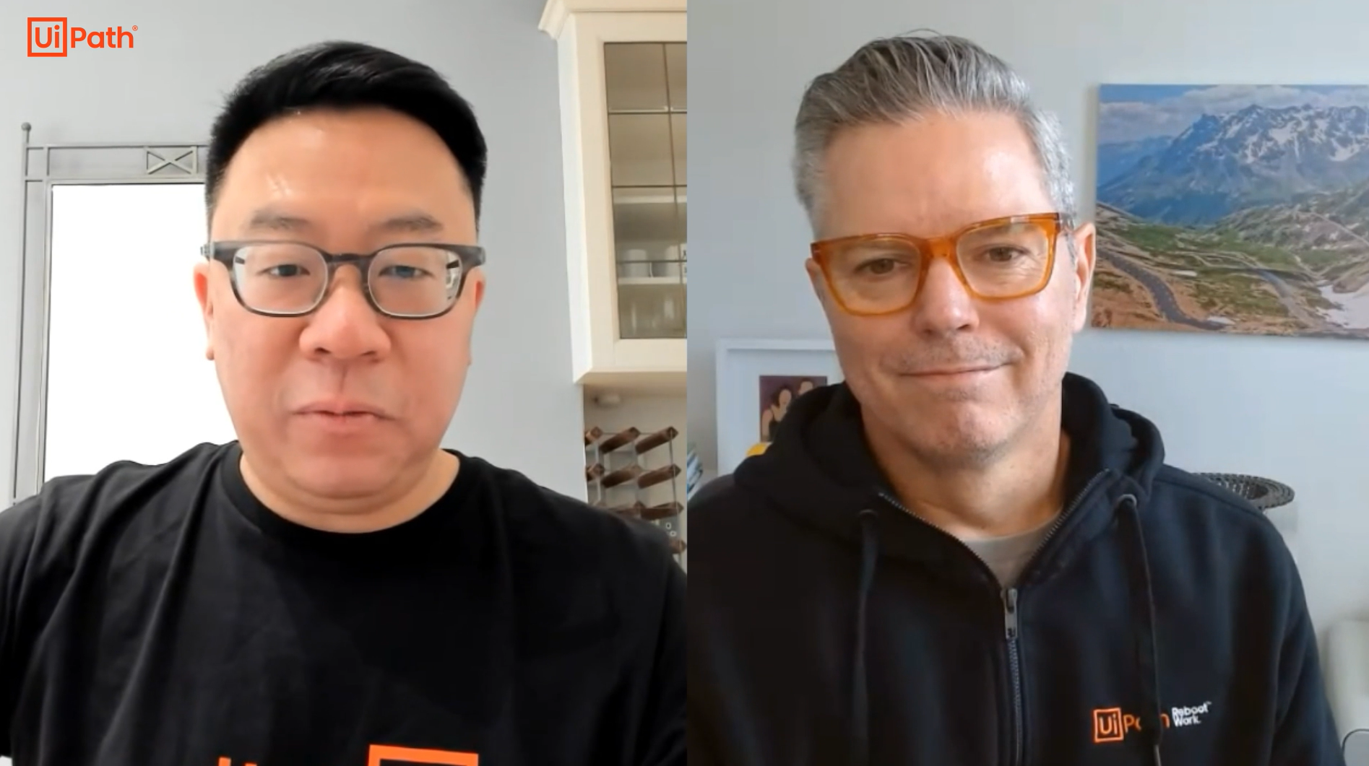
CX/CC Podcast
Thought Leadership series:
‘Demystifying the CX and Contact Center’
Your contact center is the place where your company’s reputation is won and lost. Your agents are doing everything they can to best represent the business, but they can get bogged by repetitive, labor-intensive processes and slow, siloed systems that frustrate both them and your customers. And bad interactions are bad for business. In this series, we're delving into best practices, controversial opinions, scaling value- all the good stuff. Join industry experts- Rufino Chiong and Scott Dresser along with some special guests- in Demystifying the CX and Contact Center.
Spotify Page
Demystifying the CX and Contact Center
Social Posts
LinkedIn Post
YouTube Teaser
HQ
NEXT: Episode 4 – Mid Jan

